Slide 1


HR DATA ANALYTICS
~Trainity
Deeksha Saini

Slide 2

OVERVIEW OF THE PROJECT
Analyze the company's hiring process data and draw meaningful insights from it. Understanding trends such as the number of rejections, interviews, job types, and vacancies can provide valuable insights for the hiring department.

Slide 3

OBJECTIVES OF THE PROJECT
Hiring Analysis : Determine the gender distribution of hires. How many males and females have been hired by the company?
Salary Analysis : What is the average salary offered by this company? Use Excel functions to calculate this.
Salary Distribution : Create class intervals for the salaries in the company. This will help you understand the salary distribution.
Departmental Analysis : Use a pie chart, bar graph, or any other suitable visualization to show the proportion of people working in different departments.
Position Tier Analysis : Use a chart or graph to represent the different position tiers within the company. This will help you understand the distribution of positions across different tiers.

Slide 4
APPROACH
Data was initially cleaned in Excel & Python to address inconsistencies and ensure accuracy. Using exploratory data analysis (EDA), key patterns and trends were identified, providing essential insights. The refined dataset was then analyzed in Microsoft Excel through PivotTables and PivotCharts, which offered a clear, visual interpretation of findings and supported data-driven insights.

Slide 5
TECH STACK USED
Microsoft Excel 2021: Data visualization and analysis using PivotTables and PivotCharts.
Python (Spyder IDE): Data cleaning, preprocessing, and exploratory data analysis (EDA) using libraries like Pandas and NumPy.

Slide 6

INSIGHTS & FINDINGS
Insights and Findings
Data Quality Issues:
Identified and addressed one missing value in the Offered Salary column.
Found null values in the Post name column, which were flagged for further investigation.
Outlier Analysis:
Detected three significant outliers in the Offered Salary column, potentially affecting the accuracy of salary-related analyses.
Distribution Analysis:
The distribution of Offered Salary is slightly right-skewed, indicating that most salaries are clustered on the lower end, with a few higher values stretching the tail.

Slide 7

DATA CLEANING & SIMPLE STATISTICS
Missing Values Imputation:
Mode Imputation : Filled missing values in the Post Name column using the most frequent value to ensure categorical consistency.
Median Imputation : Replaced the missing value in the Offered Salary column with the median, maintaining robustness against skewed data.
Outlier Analysis and Treatment:
Conducted outlier analysis on the Offered Salary column, adjusting outliers by capping them to the calculated upper and lower limits for a more accurate representation of the data range.

Slide 8
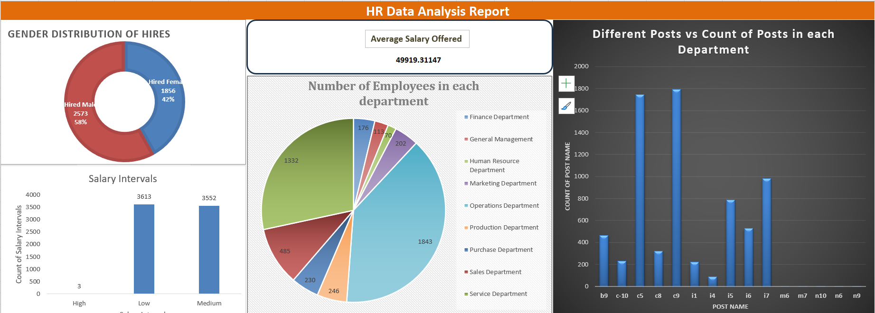

Slide 9

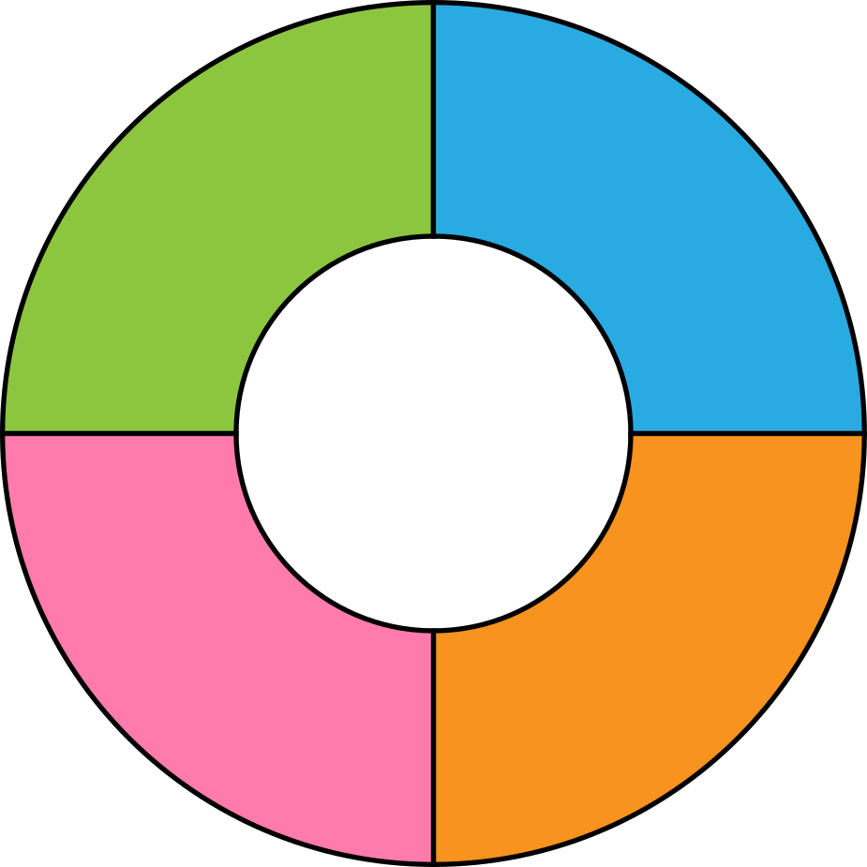

TYPES OF GRAPHS
Column Graph : Used to display different positions
Donut Graphs : Used to show Gender Distribution
Pie Graphs : Used to depict parts of a whole

Slide 10

RESULTS
1.The gender distribution of hires within the company is as follows:
Females: 42% of the total hires, which equals 1,856 females.
Males: 58% of the total hires, which equals 2,573 males.
2. The average salary offered by the company is 49,919.31.
3. The salaries were grouped into three class intervals to understand the salary distribution within the company:
Low Category : Salaries ≤ 50,000
Medium Category : Salaries > 50,000 and ≤ 100,000
High Category : Salaries > 100,000 and ≤ 150,000
4. A pie chart was created to visually represent the number of employees working in different departments. The chart provides a clear understanding of the distribution of employees across various departments within the company.
5. A column chart was displayed to represent the distribution of different posts across various departments. This visual helps illustrate the hierarchical structure and the proportion of employees in each position tier within the company.

